Slide 1
Credit Card Fraud Detection in Machine Learning
An Overview of Machine Learning Techniques for Fraud Detection

Slide 2

DEPARTMENT: MASTERS OF COMPUTER APPLICATION
TITTLE: CREDIT CARD FRAUD DETECTION USING MACHINE LEARNING
GUIDE BY: JOYJIT GUHA BISWAS
PRESENTED BY:
SLNO. | NAME | ROLL NO
1 | MITRABIK GHOSH | 504123011023
2 | PRACHURJYA DAS | 504123011025
3 | SOHAN DHARA | 504123011045
4 | SUCHARITA PANDA | 504123011051

Slide 3

CONTENTS
INTRODUCTION OF CREDIT CARD FRAUD
PYTHON LIBRARIES FOR MACHINE LEARNING
TYPES OF MACHINE LEARNING
MACHINE LEARNING FOR FRAUD DETECTION
USE MACHINE LEARNING KEY ALGORITHMS FOR FRAUD DETECTION
PERFOMANCE OF CREDITCARD FRAUD DETECTION
FUTURE SCOPE
CONCLUSION
OVERVIEW

Slide 4
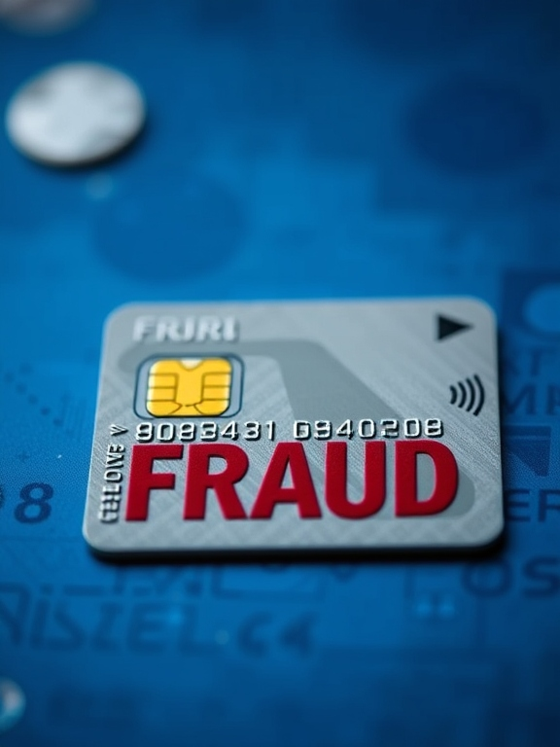
INTRODUCTION OF CREDIT CARD FRAUD
Credit card fraud is when someone uses another person's credit card or account information to make unauthorized purchases or access funds through cash advances. Credit card fraud doesn’t just happen online; it happens in brick-and-mortar stores, too.
We live in a world where cash transactions are quickly being replaced by credit card transactions.
person will not pay for the item he did not purchase.

Slide 5

PYTHON LIBRARIES FOR MACHINE LEARNING:
Numpy: Fundamental package for numerical computing, handling arrays and matrices.
Pandas: Powerful library for data manipulation and analysis, particularly for structured data (tables)
Seaborn: Seaborn is commonly used in machine learning to create informative and attractive statistical plots for exploring and understanding datasets.
Matplotlib: Matplotlib is used for visualizing data, model performance, and evaluation results through various types of plots and charts
Sklearn: Scikit-learn provides simple and efficient tools for data mining, data analysis, and building machine learning models, including algorithms for classification, regression, clustering, and dimensionality reduction.

Slide 6

Machine Learning for Fraud Detection
Objective: To identify and prevent fraudulent transactions in real-time by leveraging machine learning algorithms.
Process Overview:
Data Collection
Feature Engineering
Model Selection
Training and Validation
Real-Time Prediction
Notes:
Objective: To identify and prevent fraudulent transactions in real-time by leveraging machine learning algorithms.
Process Overview:
Data Collection
Gather transaction data: location, time, amount, merchant, device, etc.
Feature Engineering
Create features: transaction frequency, amount variability, user location patterns, etc.
Model Selection
Use algorithms like Random Forest, SVM, Neural Networks, or XGBoost.
Training and Validation
Train models on historical labeled data (fraud/non-fraud).
Validate with techniques like cross-validation.
Real-Time Prediction
Deploy model to flag suspicious transactions instantly.
False positives minimized through model fine-tuning.

Slide 7
Key Algorithms for Fraud Detection
Logistic Regression:-
Logistic regression is a supervised machine learning algorithm that accomplishes binary classification tasks by predicting the probability of an outcome, event, or observation.
2. Decision Trees:-
A decision tree is a type of supervised machine learning used to categorize or make predictions based on how a previous set of questions were answered.

Slide 8
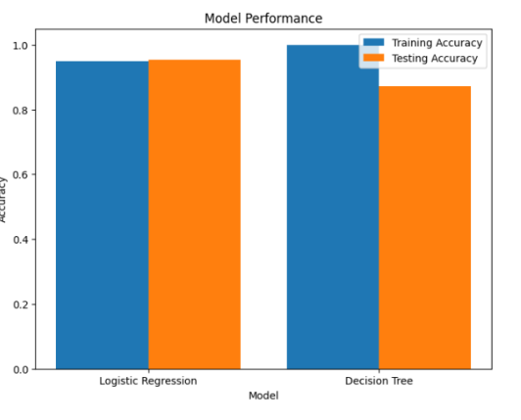
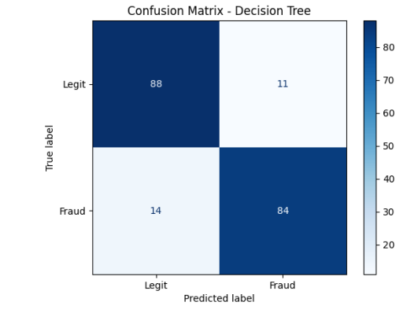
PERFOMANCE OF CREDITCARD FRAUD DETECTION

Slide 9

FUTURE SCOPE
AI & Machine Learning Advancements
Real-Time Detection
Cross-Institution Collaboration
Enhanced Customer Experience
Notes:
AI & Machine Learning Advancements: Leveraging deep learning models and neural networks for improved accuracy and faster anomaly detection.
Real-Time Detection: Enhanced algorithms for immediate detection and response to suspicious transactions, reducing fraud impact.
Cross-Institution Collaboration: Building stronger networks among financial institutions for shared insights, collective threat intelligence, and global fraud prevention.
Enhanced Customer Experience: Minimizing false positives and ensuring legitimate transactions are not interrupted, balancing security with convenience.

Slide 10

CONCLUSION
● Credit Card Fraud Detection is a developing technique.
● Machine Learning advances will achieve greater results in future.

Slide 11
THANK YOU.

